Slide 1
cts
Seamless AV
MONTHLY BUSINESS REVIEW
September 2026
Results, departments, spending, customers, cash and utilisation
Financial Controller
Notes:
Monthly Business Review for September 2026. Everything in this pack comes from the Financial Controller Pack, which ties to the Xero general ledger to the cent for every department and for the company.
The headline is that Sep 26 beat budget on revenue by 148 thousand and still lost money. Revenue was 562 thousand against a budget of 414 thousand. EBITDA was (32) thousand against a budgeted loss of (107) thousand.
The story of the month is margin and the overhead base, not sales.

Slide 2
AGENDA
What we will cover
01
Financial performance
P&L summary, the three months to date, and every department against budget
02
What we spend
Where the money goes: cost distribution, operating expense, labour and employment
03
Customers and cash
Top ten customers, receivables and days sales outstanding
04
People and utilisation
Chargeable hours by department and the profit they produce
05
Budget and outlook
Revenue by month against budget, and what we do about it
Notes:
Five sections. Financial performance first, because that is what the numbers say. What we spend second, because that is where the answer is this month. Then customers and cash, then people, then what we do about the budget.

Slide 3
INTRODUCTION
Where the business stands, Sep 26
SUPPORT
EVENTS
VIDEO
INTEGRATION
CONSULTING
$243k
$73k
$7k
$235k
$4k
revenue
revenue
revenue
revenue
revenue
42% gross margin
78% gross margin
80% gross margin
10% gross margin
2% gross margin
+$29k after overhead
$(54)k after overhead
$(7)k after overhead
+$10k after overhead
$(20)k after overhead
Behind budget by $5k
Ahead of budget by $7k
Behind budget by $10k
Ahead of budget by $176k
Behind budget by $20k
Revenue
Gross margin
Overheads
EBITDA
Break even needs
$562k
33.4%
$230k
$(32)k
$549k
budget $414k
last Sep 45.5%
budget $232k
budget $(107)k
running at $541k
The month in one line. Revenue beat budget by $148k and the company still lost $32k of EBITDA. Support is the only department that covers its own overhead. Integration delivered the revenue beat at 10.1% gross margin, so it added turnover and almost no profit. At the 38.9% margin we actually deliver, break even needs $549k of revenue a month and we are running at $541k.
Notes:
The introduction slide, colour coded by department: Support in red, Events and Video in the Production teals, Integration and Consulting in the Consulting blues.
Support: revenue 242,948, gross margin 41.7%, result 29,007 after all overhead, behind budget by 5,068.
Events: revenue 73,304, gross margin 77.6%, result (54,227) after all overhead, ahead of budget by 7,476.
Video: revenue 7,303, gross margin 79.6%, result (6,846) after all overhead, behind budget by 10,196.
Integration: revenue 234,858, gross margin 10.1%, result 10,471 after all overhead, ahead of budget by 175,586.
Consulting: revenue 3,531, gross margin 2.1%, result (19,870) after all overhead, behind budget by 19,519.
Company revenue 561,945 against 413,665 budget. Gross margin 33.4%. Overheads 230,233. EBITDA (32,437).
If the room only hears one thing from this pack, it is the last figure on the strip. At our real margin we need 549,372 of revenue every month to break even and we are averaging 541,487.

Slide 4
SECTION
01
Financial performance
The P&L for September 2026 and the year to date
Notes:
Three months of FY27 are closed. Revenue is running at 541 thousand a month and break even needs 549 thousand at the margin we actually deliver. That is the whole problem in one line.

Slide 5
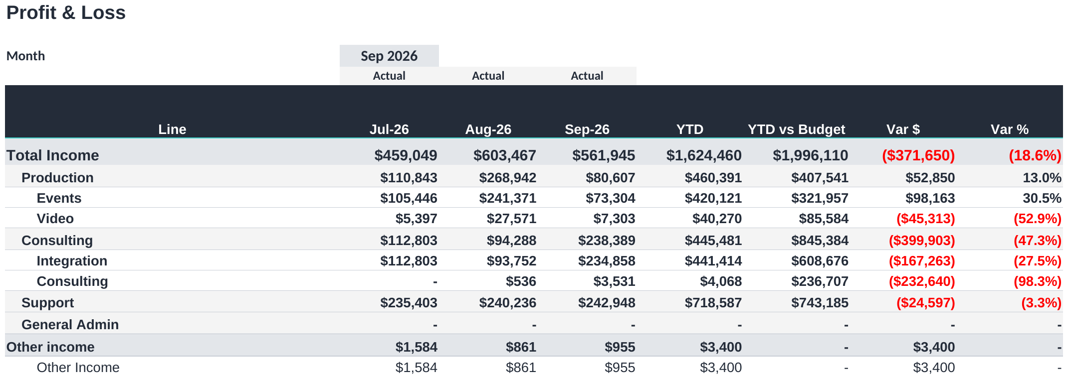
FINANCIAL PERFORMANCE
P&L summary, income
COMMENTARY
We need 549k of sales a month just to cover our costs. We are averaging 541k.
Sep 26 sold 148k more than planned and still lost 32k. We sold enough. We did not keep enough of it.
We kept 33% of every dollar sold. The plan said 30%, but last September we kept 46%.
Running costs came in at 230k against 232k planned. Spending is not the problem.
Profit for the quarter is 6k against 223k planned. The plan needs redoing around what we keep, not what we sell.
Snipped from the Financial Controller Pack, Summary tab, income by department, the three closed months and year to date.
Notes:
P&L summary, straight off the Summary tab with the outline shut, so this is the view on screen.
Revenue 561,945 against a budget of 413,665, ahead by 148,280. Against last September at 356,323 we are up 58%.
Gross profit 187,814 at 33.4%, against a budget of 30.1% and last September at 45.5%. The budget margin for this month was unusually low, so beating it is not the achievement it looks like.
Overheads 230,233 against 231,573 budget. Spending is behaving.
EBITDA (32,437) against a budgeted (107,100). Net profit (41,464) after depreciation and amortisation of 9,982.
Year to date revenue 1,624,460 against 1,996,110, behind by 371,650. EBITDA 5,774 against 222,700.
The line to leave in the room: at 38.9% gross margin we need 549,372 of revenue every month to cover overhead. We are averaging 541,487. That gap is structural and selling more at this margin will not close it.

Slide 6
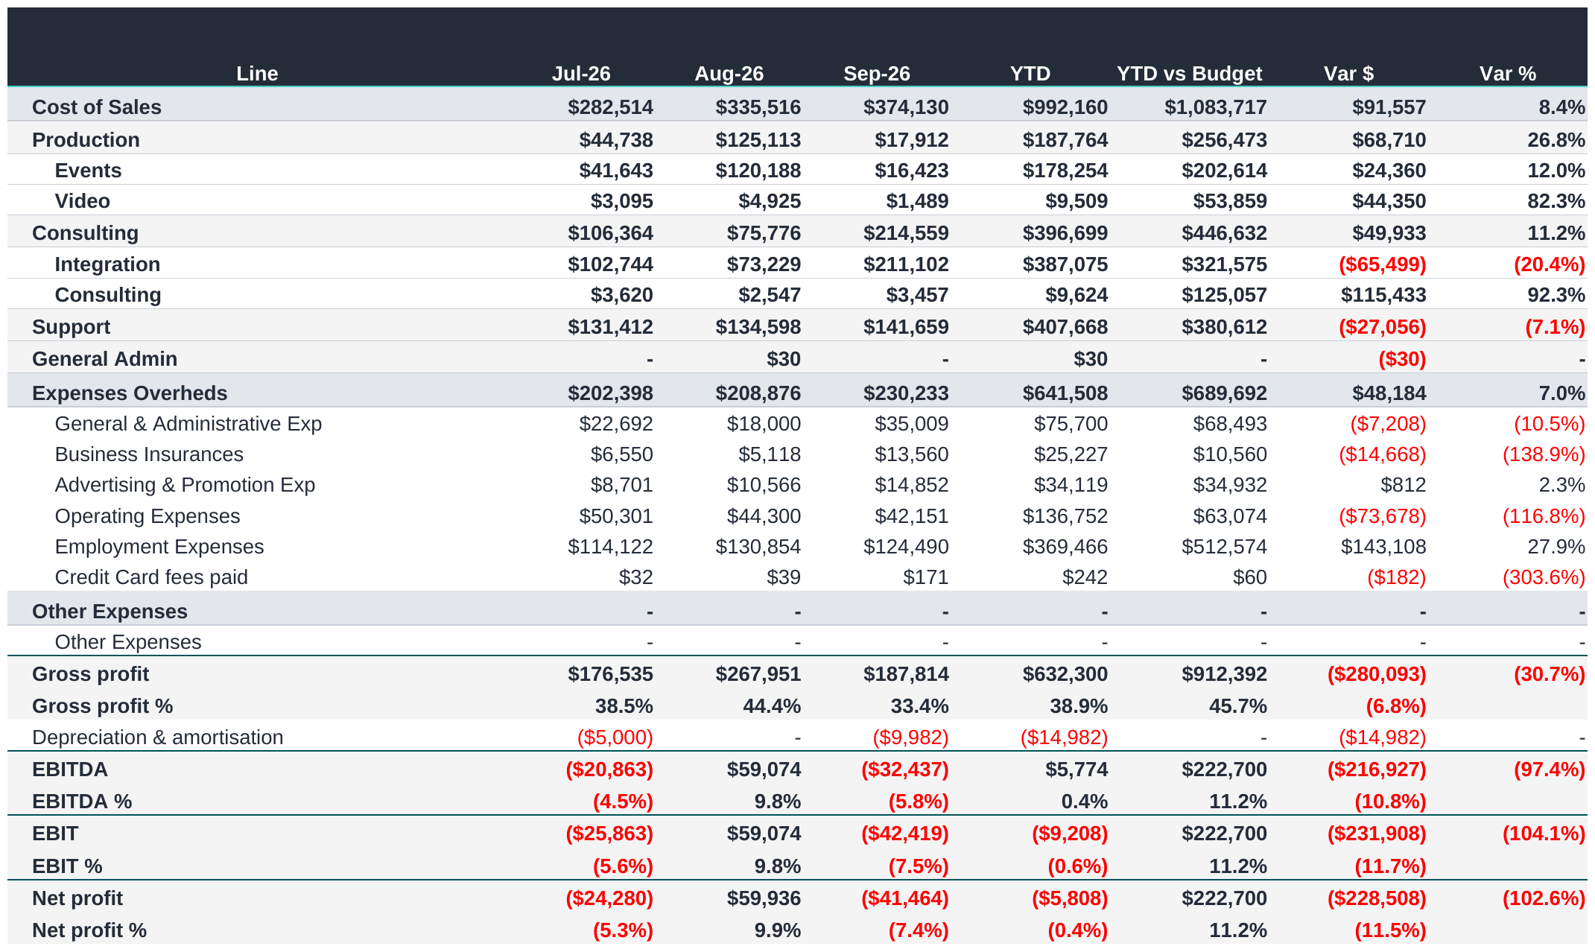
FINANCIAL PERFORMANCE
P&L summary, cost and profit
COMMENTARY
Operating profit, or EBITDA, is 6k for the quarter against 223k planned. We are 217k short, which is 97% of it.
The plan expected 56% of the year's profit in these first three months. It did not happen, so the whole year now rides on the nine months left.
To still hit the 397k target those nine months have to make 391k. The plan only ever asked them for 175k.
391k is 1.7 times what the whole of last year made, which was 235k. We will not get the year back.
The problem is what we keep, not what we sell. Sales hit 81% of plan. What was left after direct costs hit only 69%.
Snipped from the Financial Controller Pack, Summary tab, cost of sales, overheads and the profit lines.
Notes:
The risk in one slide: EBITDA against what was budgeted.
The quarter produced 5,774 of EBITDA against a budget of 222,700. That is a miss of 216,927, or 97.4%.
Why it matters more than the number suggests. The FY27 budget is 397,251 of EBITDA for the year, and it put 222,700 of that, 56%, into the first quarter. The year was planned to be earned early. It was not, so the remaining nine months now have to carry the whole thing.
To still land on 397,251 the nine months from October must produce 391,477, which is 43,497 a month. The budget itself only asked those nine months for 174,551, or 19,395 a month. We would need 2.2 times the monthly profit the plan assumed, in the months the plan already treated as the quiet ones.
Put it against last year and it is clearer. The whole of FY26 delivered 235,273 of EBITDA. The next nine months would need 391,477, which is 1.7 times a full year of last year's earnings. My view is that the full year EBITDA budget is not recoverable and the board should be told that now rather than at the half year.
The cause is margin, not sales. Revenue for the quarter came in at 81.4% of budget, which is not a bad result on its own. Gross profit came in at 69.3% of budget. The gap between those two percentages is the whole problem: we sold reasonably well and kept very little of it. September is the clearest example, where revenue beat budget by 148,280 and the month still lost 32,437 of EBITDA.
Nothing in what we spend can soak that up. Overheads ran at 641,508 for the quarter, 213,836 a month, and came in 48,184 under budget. Spending is not the problem and there is nothing more to cut that would matter. Wages and the office are what we spend, and both are locked in for the year. So when we keep less of each sale it goes straight off the profit.
Where that leaves break even. At the 38.9% gross margin we actually deliver, the business needs 549,372 of revenue a month to cover overhead. We are running at 541,487. The business is trading at break even, not at a profit, and it is doing so in the quarter the budget expected to be the strongest.
Two things make the next two quarters harder, not easier. December is budgeted at a loss because the business closes for two weeks, so Q2 cannot make the gap up. And with EBITDA at break even there is no earnings buffer, while 303,605 of cash sits in debtors above the 30 day target.
The one piece of genuine good news: last year's first quarter was a loss of 85,404. This quarter is 91,178 better than that. The business is improving year on year. It is the budget that was set above what the business can deliver, and that is the distinction to draw in the room.
What I am recommending. Reforecast now, on margin rather than revenue. Rebuild Consulting around the capacity that actually exists. Reset the gross margin assumption to the rate delivered over two years rather than the rate in the plan. Hold December as budgeted. And give the board a revised full year EBITDA they can rely on, because the one in front of them cannot be met.

Slide 7
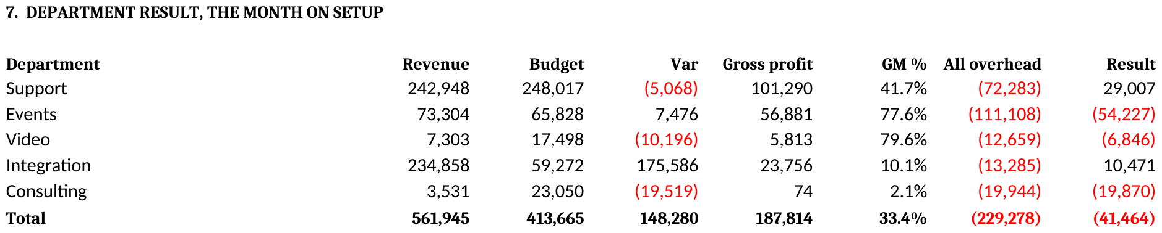
FINANCIAL PERFORMANCE
Department result, Sep 26
Snipped from the Financial Controller Pack, Overhead Split tab, section 7, department result.
COMMENTARY
Support is the only department earning enough to cover its share of running costs. It made 29k on 243k of sales.
Events is charged 111k of running costs and only billed 73k. It keeps 78% of what it sells and still loses 54k.
Integration billed 235k against a 59k plan but keeps only 10% of it, so it made just 10k.
Consulting is charged 20k of running costs and billed 4k. That needs a decision, not a forecast.
Notes:
Every department against budget with the full overhead charge, read off section 7 of the Overhead Split tab.
Support: revenue 242,948 against 248,017 budget. Gross profit 101,290 at 41.7%. Overhead 72,283, of which 59,182 is allocated admin. Result 29,007.
Events: revenue 73,304 against 65,828 budget. Gross profit 56,881 at 77.6%. Overhead 111,108, of which 71,672 is allocated admin. Result (54,227).
Video: revenue 7,303 against 17,498 budget. Gross profit 5,813 at 79.6%. Overhead 12,659, of which 9,782 is allocated admin. Result (6,846).
Integration: revenue 234,858 against 59,272 budget. Gross profit 23,756 at 10.1%. Overhead 13,285, of which 4,148 is allocated admin. Result 10,471.
Consulting: revenue 3,531 against 23,050 budget. Gross profit 74 at 2.1%. Overhead 19,944, of which 13,979 is allocated admin. Result (19,870).
The five departments total (41,464), which is net profit for the month.
Two things to flag. Integration sold 175,586 more than planned and it turned into almost no profit, because we keep only 10.1% on reselling equipment. And Events is charged 71,672 of office costs on 73,304 of sales. That charge is split on who uses the office, and Events is not the department sitting in it.

Slide 8
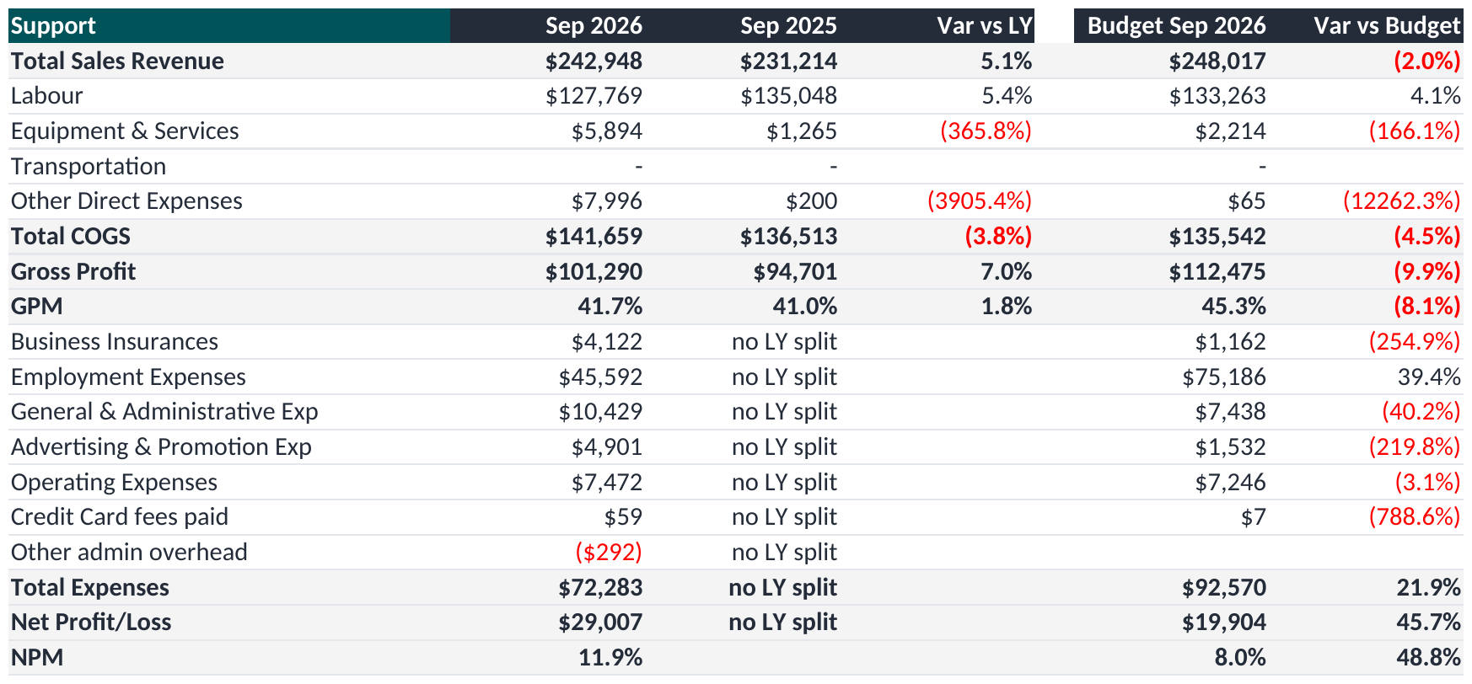
FINANCIAL PERFORMANCE
Support, Sep 26
COMMENTARY
Billed 243k against 248k. Within 5k of plan, which is what fixed monthly contracts should do.
Keeps 42% of what it sells, the same as last September. Steady and predictable.
After its 72k share of running costs it still made 29k. The only department that does.
Of that share, 42,262 is office wages. Support picks up the most because it works the most hours.
The one thing not to trust here is the 99% billable figure. Non-billable time is being booked to jobs.
Snipped from the Financial Controller Pack, Dept P&L tab, the department selector set to Support.
Notes:
Support for September 2026, read off the Dept P&L tab.
Sales 242,948 against a budget of 248,017, behind by 5,068. Last September it billed 231,214.
After direct costs of 141,659 it kept 101,290, which is 41.7% of what it sold.
Running costs charged to it were 72,283. 13,101 of that is its own spending and 59,182 is its share of the office, charged on the keys set in the pack.
That leaves 29,007 for the month.
Year to date it has billed 718,587 against a budget of 743,185.
On people: employment expense of 51,242, of which 8,980 is its own staff and 42,262 is its share of office wages. It put 2,132 hours onto jobs and 11 onto work we cannot bill, with 218 hours of leave.

Slide 9
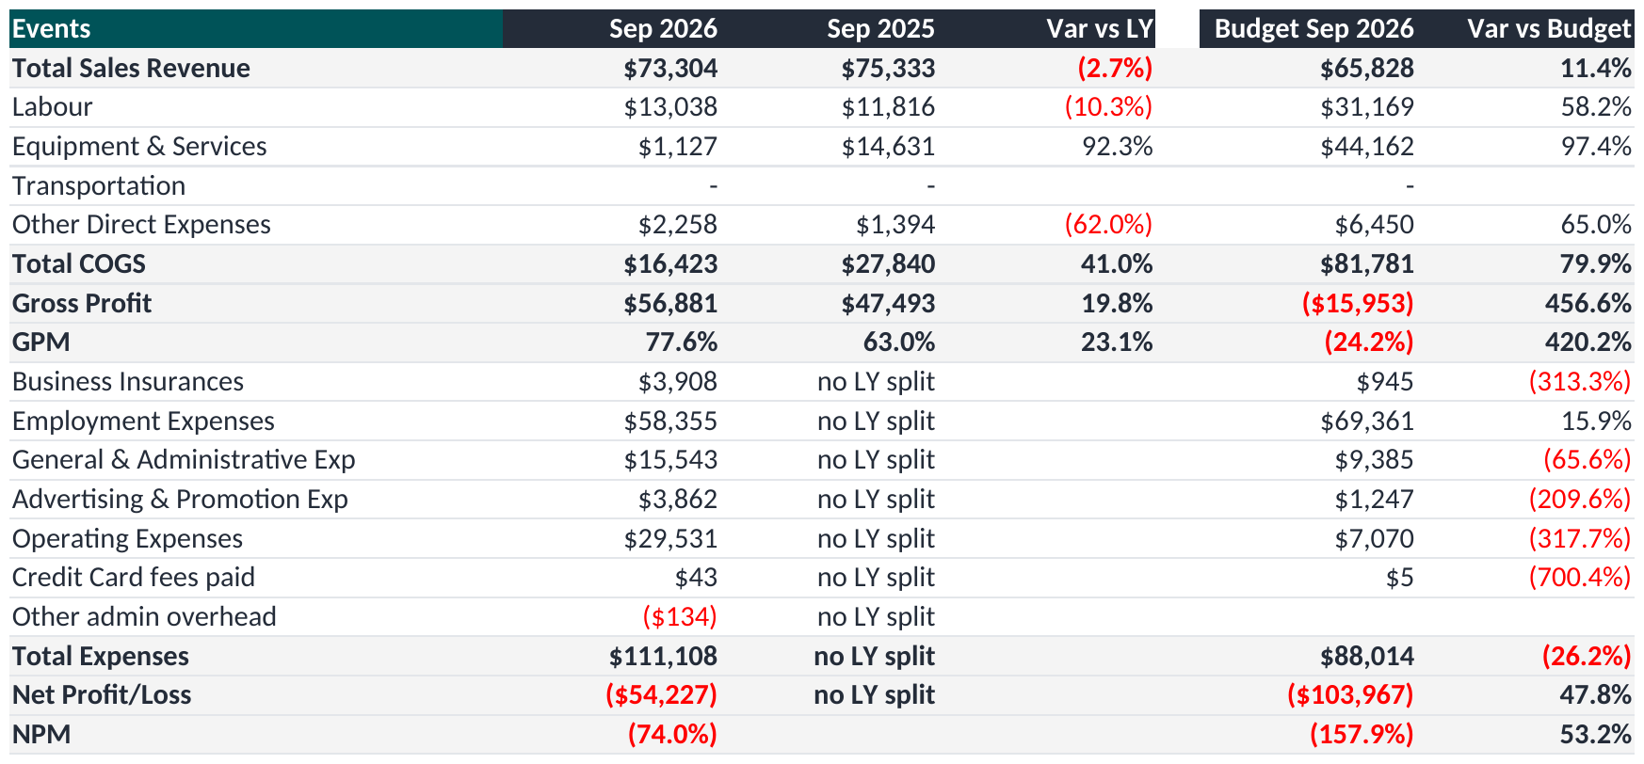
FINANCIAL PERFORMANCE
Events, Sep 26
COMMENTARY
Billed 73k against 66k, in a month between the busy results periods.
Keeps 78% of what it sells, the second best in the business.
And still loses 54k, because it is charged 111k of running costs on 73k of sales.
72k of that is office cost, split on who uses the office. Events is not the department sitting in it.
333 hours went to leave and only 241 onto jobs. The people were there, the work was not.
Snipped from the Financial Controller Pack, Dept P&L tab, the department selector set to Events.
Notes:
Events for September 2026, read off the Dept P&L tab.
Sales 73,304 against a budget of 65,828, ahead by 7,476. Last September it billed 75,333.
After direct costs of 16,423 it kept 56,881, which is 77.6% of what it sold.
Running costs charged to it were 111,108. 39,436 of that is its own spending and 71,672 is its share of the office, charged on the keys set in the pack.
That leaves (54,227) for the month.
Year to date it has billed 420,121 against a budget of 321,957.
On people: employment expense of 50,959, of which 35,665 is its own staff and 15,294 is its share of office wages. It put 241 hours onto jobs and 249 onto work we cannot bill, with 333 hours of leave.

Slide 10
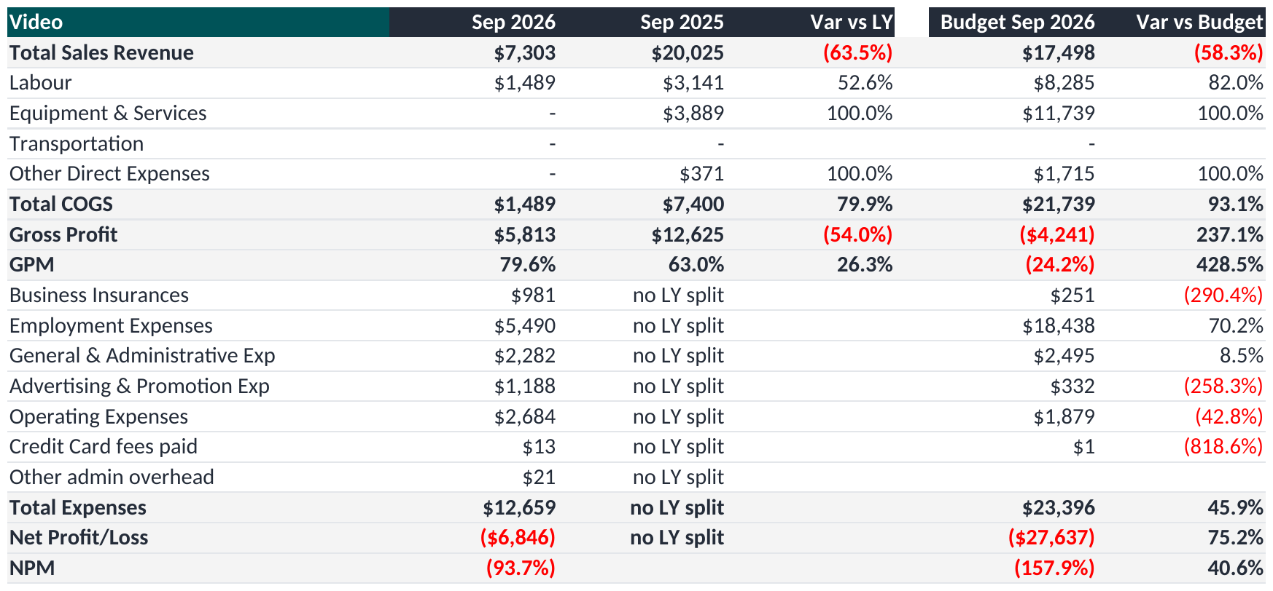
FINANCIAL PERFORMANCE
Video, Sep 26
COMMENTARY
Billed 7k against 17k. Short of plan for the third month running.
Keeps 80% of what it sells, the best margin in the business.
But on 7k of sales that is only 6k, against 13k of running costs.
The margin is not the problem. There is not enough work going through it.
25 billable hours in the month. That is one person, part of the time.
Snipped from the Financial Controller Pack, Dept P&L tab, the department selector set to Video.
Notes:
Video for September 2026, read off the Dept P&L tab.
Sales 7,303 against a budget of 17,498, behind by 10,196. Last September it billed 20,025.
After direct costs of 1,489 it kept 5,813, which is 79.6% of what it sold.
Running costs charged to it were 12,659. 2,878 of that is its own spending and 9,782 is its share of the office, charged on the keys set in the pack.
That leaves (6,846) for the month.
Year to date it has billed 40,270 against a budget of 85,584.
On people: employment expense of 3,961, of which 2,660 is its own staff and 1,301 is its share of office wages. It put 25 hours onto jobs and 8 onto work we cannot bill, with 0 hours of leave.

Slide 11
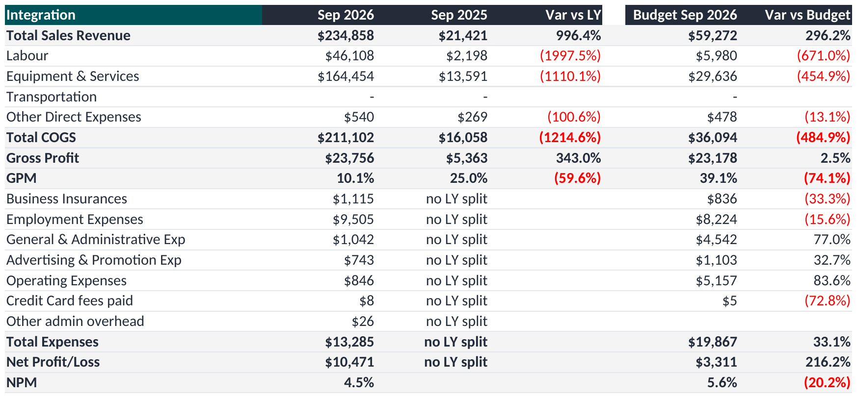
FINANCIAL PERFORMANCE
Integration, Sep 26
COMMENTARY
Billed 235k against a 59k plan. Nearly all of it one installation job, now finished.
Keeps only 10% of it. We bought the equipment and resold it, so the money went mostly to suppliers.
235k of sales turned into 24k. Do not read the revenue line as a good month.
It shows a 10k profit only because it carries almost no running costs, 13k.
10 billable hours against 235k of sales. We resold, we did not deliver.
Snipped from the Financial Controller Pack, Dept P&L tab, the department selector set to Integration.
Notes:
Integration for September 2026, read off the Dept P&L tab.
Sales 234,858 against a budget of 59,272, ahead by 175,586. Last September it billed 21,421.
After direct costs of 211,102 it kept 23,756, which is 10.1% of what it sold.
Running costs charged to it were 13,285. 9,136 of that is its own spending and 4,148 is its share of the office, charged on the keys set in the pack.
That leaves 10,471 for the month.
Year to date it has billed 441,414 against a budget of 608,676.
On people: employment expense of 8,832, of which 8,563 is its own staff and 269 is its share of office wages. It put 10 hours onto jobs and 0 onto work we cannot bill, with 0 hours of leave.

Slide 12
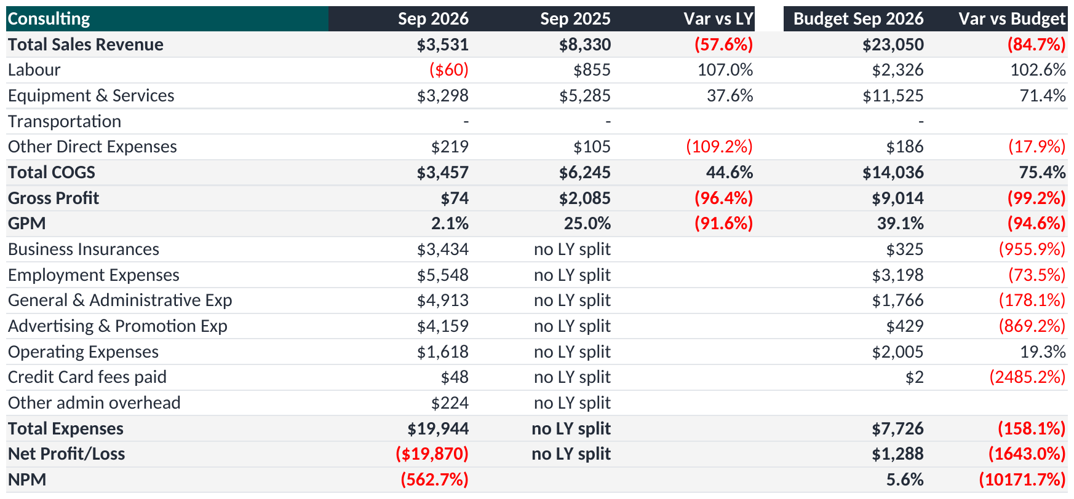
FINANCIAL PERFORMANCE
Consulting, Sep 26
COMMENTARY
Billed 4k against a 23k plan. There is almost no fee income here.
Carries 20k of running costs against 4k of sales, so it loses 20k.
84 hours went into work we cannot bill against 31 we can.
Year to date it has billed 4k against a 237k plan.
This is a decision for the board, not a forecast. Rebuild it, merge it into Integration, or close it.
Snipped from the Financial Controller Pack, Dept P&L tab, the department selector set to Consulting.
Notes:
Consulting for September 2026, read off the Dept P&L tab.
Sales 3,531 against a budget of 23,050, behind by 19,519. Last September it billed 8,330.
After direct costs of 3,457 it kept 74, which is 2.1% of what it sold.
Running costs charged to it were 19,944. 5,965 of that is its own spending and 13,979 is its share of the office, charged on the keys set in the pack.
That leaves (19,870) for the month.
Year to date it has billed 4,068 against a budget of 236,707.
On people: employment expense of 9,496, of which 5,545 is its own staff and 3,951 is its share of office wages. It put 31 hours onto jobs and 84 onto work we cannot bill, with 53 hours of leave.

Slide 13
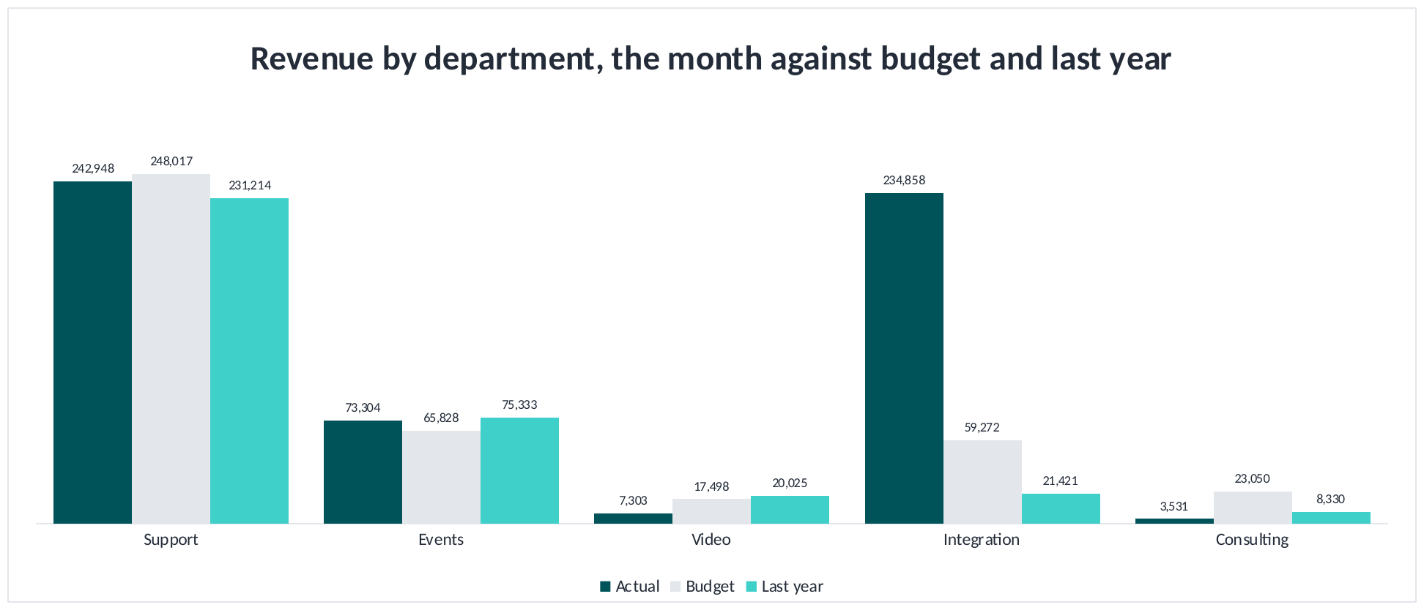
FINANCIAL PERFORMANCE
Revenue against budget and last year
COMMENTARY
Integration billed 235k against a 59k plan. Nearly all of it was one big installation job, now finished, so next month drops back.
Support billed 243k against 248k. On plan, which is what fixed monthly contracts should do.
Events billed 73k against 66k, in a month that sits between the busy results periods.
Video billed 7k against 17k and Consulting 4k against 23k. Both have been short every month this year.
Company sales are 58% up on last September. We are selling more than last year and keeping less of it.
Snipped from the Financial Controller Pack, Cost Analysis tab, revenue by department, the month.
Notes:
Revenue by department for September 2026, actual against budget and against the same month last year.
Support: 242,948 against a budget of 248,017 and 231,214 last year.
Integration: 234,858 against a budget of 59,272 and 21,421 last year.
Events: 73,304 against a budget of 65,828 and 75,333 last year.
Video: 7,303 against a budget of 17,498 and 20,025 last year.
Consulting: 3,531 against a budget of 23,050 and 8,330 last year.
Company revenue 561,945 against 413,665 budget and 356,323 last September.
The beat is Integration, and it is one large fit-out at 10.1% gross margin. Read it as timing, not growth. Video and Consulting are short of budget for the third month running.

Slide 14
SECTION
02
What we spend
Where the money goes and which lines move
Notes:
Running costs are steady at about 214 thousand a month. Spending is not the problem, but that is the number sales have to beat.

Slide 15
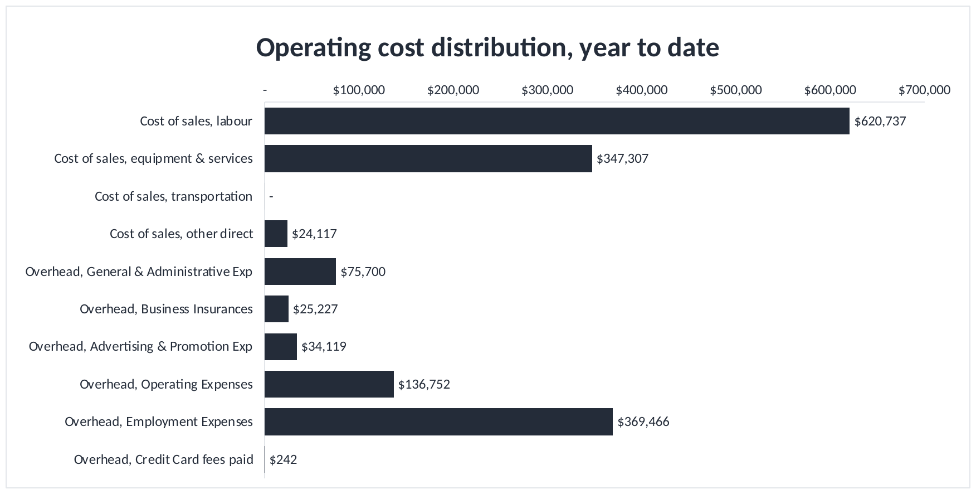
WHAT WE SPEND
Operating cost distribution, year to date
COMMENTARY
Wages for people on jobs (621)k, and wages for everyone else (369)k. Together that is most of what we spend.
Wages are what this business spends its money on. Everything else is small next to them.
The (369)k of wages for people not on jobs is the same every month. When sales drop this does not, so a bad month lands straight on the profit.
Equipment and services at (347)k is the only cost that rises and falls with the work.
If we have to cut cost it is people or the office. Nothing else is big enough to matter.
Snipped from the Financial Controller Pack, Cost Analysis tab, operating cost distribution.
Notes:
Operating cost distribution for the year to date, cost of sales and overhead on one scale.
Cost of sales, labour 620,737 at 38.0%. Cost of sales, equipment & services 347,307 at 21.3%. Cost of sales, other direct 24,117 at 1.5%. Overhead, General & Administrative Exp 75,700 at 4.6%. Overhead, Business Insurances 25,227 at 1.5%. Overhead, Advertising & Promotion Exp 34,119 at 2.1%. Overhead, Operating Expenses 136,752 at 8.4%. Overhead, Employment Expenses 369,466 at 22.6%.
The message is how concentrated it is. Wages for people on jobs and wages for everyone else are the bulk of it, and the second group is fixed for the year, which is why a quiet month drops straight off the profit.
When the board asks what we can cut, the honest answer is staff numbers or the office. Trimming subscriptions and travel will not change this.

Slide 16
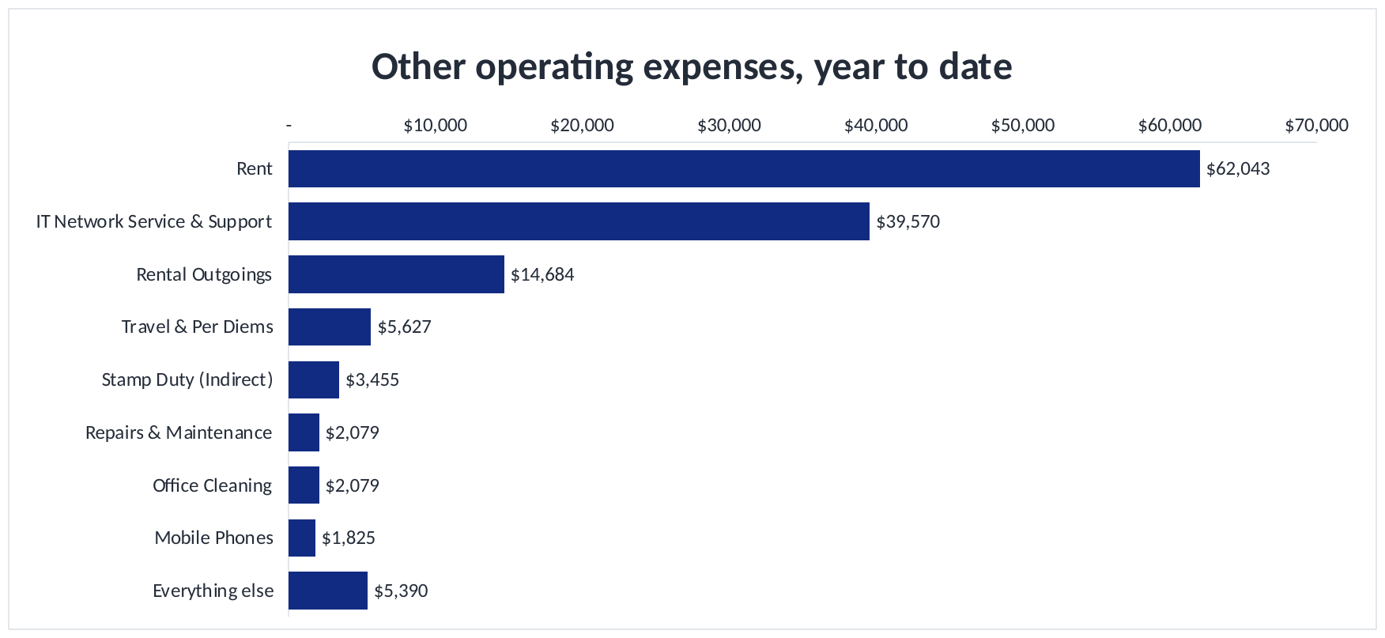
WHAT WE SPEND
Other operating expenses, year to date
COMMENTARY
The office is the big one: rent (62)k plus outgoings (15)k, 77k together.
IT support at (40)k is next, and the only one that moves much month to month.
Everything below the top three is under six thousand across a full quarter.
There is nothing worth saving further down the list. Do not spend management time there.
The office is the only real saving here, and that is a lease decision, not a budget one.
Snipped from the Financial Controller Pack, Cost Analysis tab, other operating expenses.
Notes:
Other operating expenses, year to date.
Rent 62,043 at 45.4%. IT Network Service & Support 39,570 at 28.9%. Rental Outgoings 14,684 at 10.7%. Travel & Per Diems 5,627 at 4.1%. Stamp Duty (Indirect) 3,455 at 2.5%. Repairs & Maintenance 2,079 at 1.5%. Office Cleaning 2,079 at 1.5%. Mobile Phones 1,825 at 1.3%. Everything else 5,390 at 3.9%.
Rent and outgoings are fixed by the lease. IT support is the next largest and the only one that moves.
The practical conclusion is that savings do not come from here. Cutting this meaningfully means talking about the office lease.

Slide 17
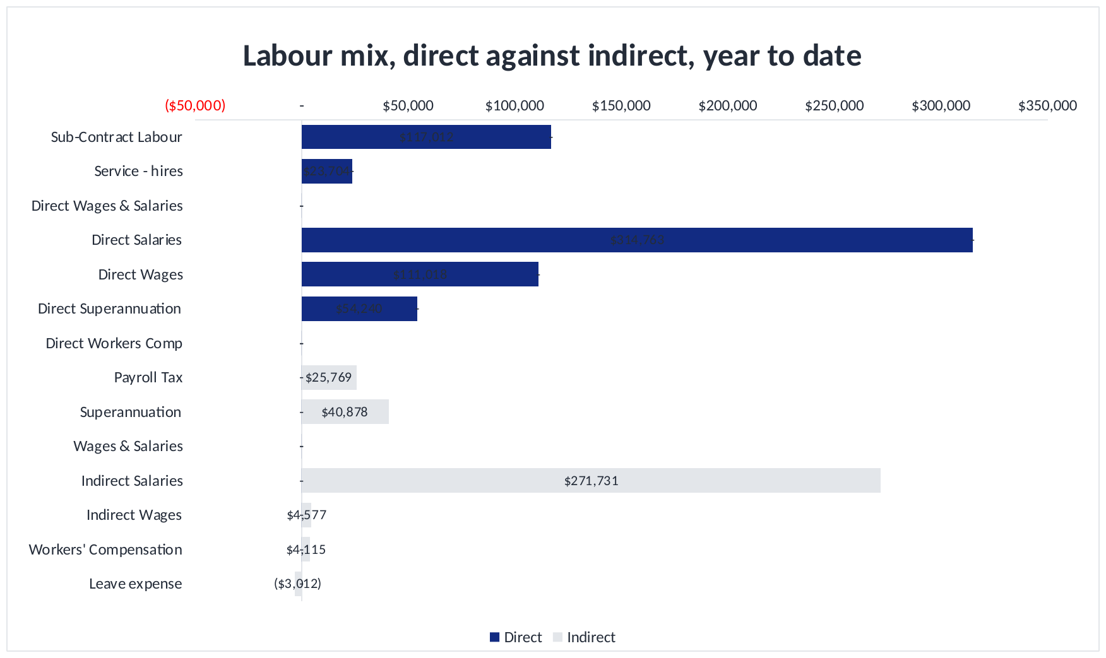
WHAT WE SPEND
Labour mix, year to date
COMMENTARY
Labour on jobs splits two ways: our own staff, and contractors we bring in.
Salaries, wages and super are most of it, and we are committed to paying them.
Contractors are the only labour cost that goes up and down with the work.
It rises when our own team runs out of hours, so watch it against the utilisation page.
We pay for every hour worked. We only bill the hours spent on jobs. The difference is profit we never make.
Snipped from the Financial Controller Pack, Cost Analysis tab, labour mix, direct against indirect.
Notes:
Labour mix for the year to date, direct labour charged to cost of sales split by type.
Sub-Contract Labour 117,012. Service - hires 23,704. Direct Salaries 314,763. Direct Wages 111,018. Direct Superannuation 54,240.
The great majority is permanent payroll. Contractors are the only labour cost that rises and falls with the work.
This is the link to the utilisation section. We pay for hours worked and we bill for hours that are chargeable. Where those two diverge, margin goes with it.

Slide 18
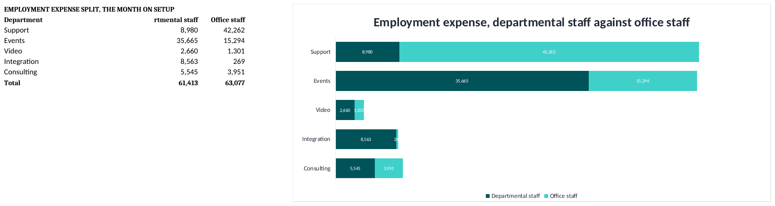
WHAT WE SPEND
Employment expense, office and departmental
Snipped from the Financial Controller Pack, Overheads MoM tab, employment expense split, the month.
COMMENTARY
63,077 of office wages this month, and all of it is charged out to the departments.
Support picks up 67% of it, based on its share of hours worked over the last twelve months.
Events pays more for its own staff, 35,665, than it does for office staff.
Integration picks up almost no office wages, because almost no hours were booked to it.
Notes:
Employment expense split between office staff and departmental staff for September 2026.
Departmental staff is the employment expense on each department's own cost centre: Support 8,980, Events 35,665, Video 2,660, Integration 8,563, Consulting 5,545.
Office staff is the admin employment pot of 63,077, charged across the departments on their share of full time equivalent: Support 42,262, Events 15,294, Video 1,301, Integration 269, Consulting 3,951.
FTE is rolling twelve month worked hours on that cost centre divided by 2,024 hours, being 253 working days at eight. That is the method in the training recording.
The change worth noting is that this no longer relies on a typed figure. The pack calculates it from the Labour Hours Report, so it reproduces every month without anyone deciding it.

Slide 19
SECTION
03
Customers and cash
Who pays us, how much, and how slowly
Notes:
Revenue is concentrated and cash is slow. Days sales outstanding is 47.2 against a 30 day target, which is 303,605 of cash sitting in the debtor book above where it should be.

Slide 20
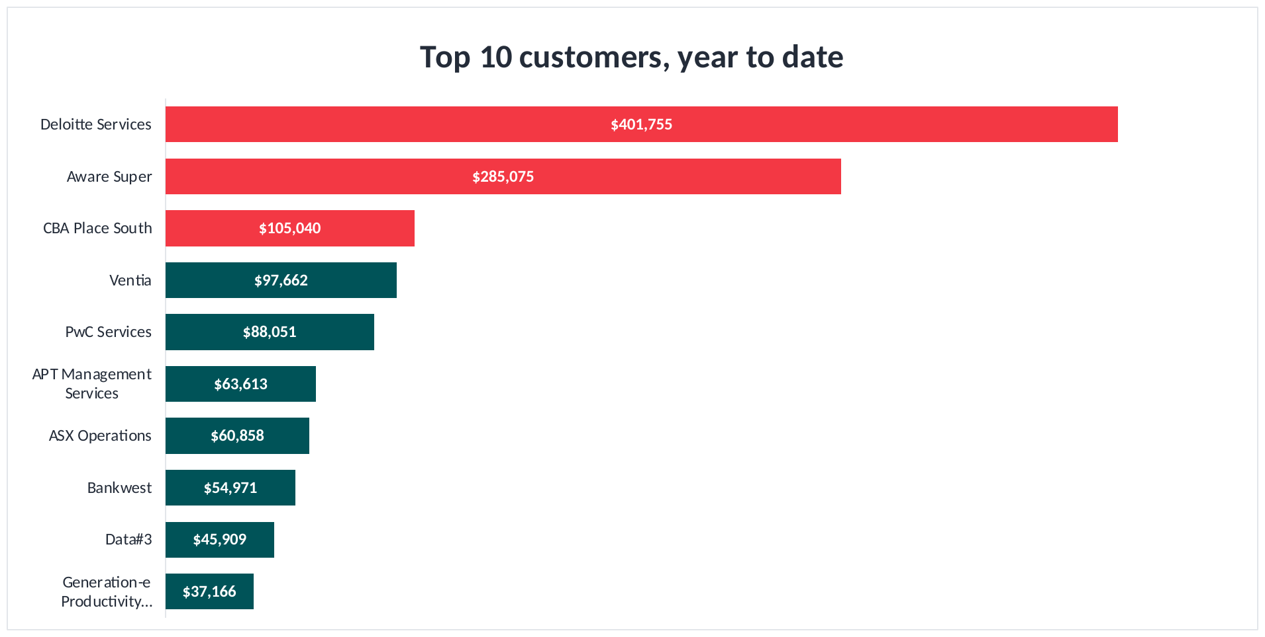
CUSTOMERS AND CASH
Top ten customers, year to date
COMMENTARY
The three red bars are 49% of everything we sold this year.
All ten together are 76%. Every other customer we have is the remaining 24%.
Deloitte Services at 401,755 is 25% on its own. Losing them would wipe out more than the whole year's profit plan.
Aware Super came from nothing to 285,075 in a quarter, and nearly all of it was one job in September.
After the top five it falls away fast. Number ten is only 37,166.
Snipped from the Financial Controller Pack, Top 10 Clients tab, top ten customers by revenue, the top three in red.
Notes:
Top ten customers by revenue, year to date, with the top three called out in red.
1. Deloitte Services: 401,755 for the year, 24.7% of the total, 119,614 of it in September 2026.
2. Aware Super: 285,075 for the year, 17.5% of the total, 241,178 of it in September 2026.
3. CBA Place South: 105,040 for the year, 6.5% of the total, 30,409 of it in September 2026.
4. Ventia: 97,662 for the year, 6.0% of the total, 9,105 of it in September 2026.
5. PwC Services: 88,051 for the year, 5.4% of the total, 26,707 of it in September 2026.
6. APT Management Services: 63,613 for the year, 3.9% of the total, 4,527 of it in September 2026.
7. ASX Operations: 60,858 for the year, 3.7% of the total, 17,167 of it in September 2026.
8. Bankwest: 54,971 for the year, 3.4% of the total, 17,230 of it in September 2026.
9. Data#3: 45,909 for the year, 2.8% of the total, 0 of it in September 2026.
10. Generation-e Productivity…: 37,166 for the year, 2.3% of the total, 12,389 of it in September 2026.
The ten together are 1,240,100, or 76.3% of everything we sold. Every other customer on the books makes up the remaining 384,360.
The three red bars are the point of the slide. They are 48.7% of the year between them.
The difference that matters is contract work against one-off projects. Deloitte Services is contracted support that renews every month. Aware Super is a fit-out that has finished. Counting them as the same kind of income is how a forecast goes wrong.
What I am recommending: a named owner for each of the top three before the half year, and the new business target set on customers four to twenty rather than on the ones we already have.

Slide 21
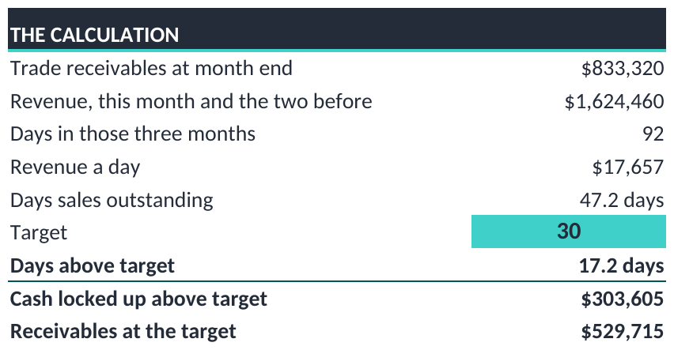
CUSTOMERS AND CASH
How long customers take to pay
COMMENTARY
Customers take 47 days to pay us. We want 30.
That is 17 days of sales sitting in the debtor book instead of the bank.
In money, 303,605 that should be ours already.
Every single day we pull that back brings in 17,657.
This is the fastest cash available to the business this quarter. Nothing else comes close.
Snipped from the Financial Controller Pack, DSO tab, the calculation, built off the Xero age analysis.
Notes:
How long customers take to pay, at 30 September 2026.
We are owed 833,320. Across the last three months we sold 1,624,460, which over 92 days is 17,657 of sales a day. Divide what we are owed by that and it takes customers 47.2 days to pay us.
The target is 30 days. We are 17.2 days over it. If we collected on time we would be owed 529,715 instead of 833,320, so 303,605 of cash that should already be ours is sitting in the debtor book.
Put that next to the profit position. The quarter made 5,774. There is 303,605 of our own money uncollected. Collecting it is worth many times more than anything we can trade our way to between now and Christmas, and it costs nothing but phone calls.
Every day we take off the number brings in 17,657.

Slide 22
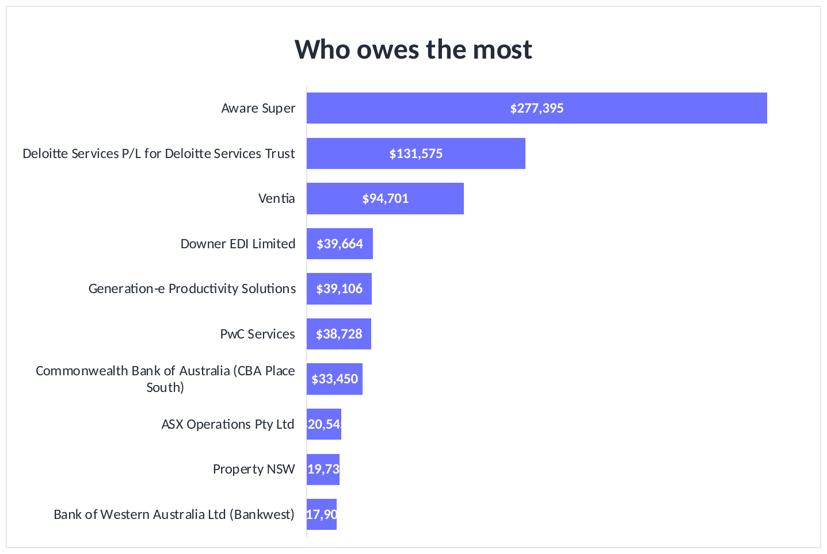
CUSTOMERS AND CASH
Who owes us the most
COMMENTARY
Aware Super owes 277,395 on its own, 33% of everything owed to us.
With Deloitte Services P/L for Deloitte Services Trust at 131,575, two customers hold 49% of the book.
29% of what we are owed is already late, 244,538.
Chase those two first. Everything below them is small by comparison.
A general collections push is not the answer. Two phone calls are.
Snipped from the Financial Controller Pack, DSO tab, the ten largest amounts owed at month end.
Notes:
The ten largest amounts owed at 30 September 2026.
Aware Super: 277,395, 33.3% of the total.
Deloitte Services P/L for Deloitte Services Trust: 131,575, 15.8% of the total.
Ventia: 94,701, 11.4% of the total.
Downer EDI Limited: 39,664, 4.8% of the total.
Generation-e Productivity Solutions: 39,106, 4.7% of the total.
The ageing: Current 588,782 at 70.7%, Under 1 month 133,177 at 16.0%, 1 month 86,553 at 10.4%, 3 months 24,809 at 3.0%. Late in total 244,538, or 29.3% of the book.
The action here is narrow and that is the point. Two customers hold most of the balance. A targeted chase on those two is worth more than a general collections exercise across everyone, and it is the fastest money available to us this quarter.

Slide 23
SECTION
04
People and utilisation
Chargeable hours and the profit they produce
Notes:
The company billed 2,437 chargeable hours in September 2026 out of 2,789 worked. Where chargeable hours fall short, margin follows.

Slide 24
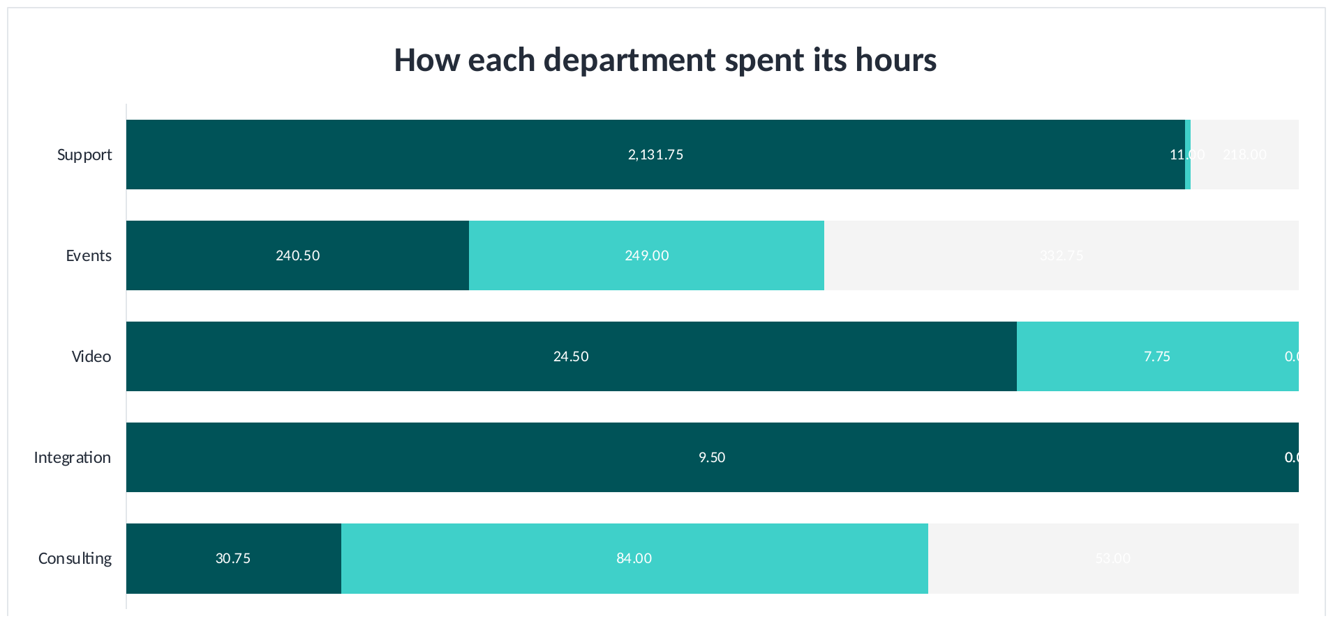
PEOPLE AND UTILISATION
How each department spent its hours, Sep 26
COMMENTARY
Each bar is scaled to that department's own hours, so you can compare the mix. Support works about a hundred times the hours Integration does.
Support shows 11 hours not on jobs out of 2,143 worked. That is not credible.
Events put 333 hours into leave and only 241 onto jobs. The people are there, the work is not.
Consulting put 84 hours into work we cannot bill against 31 we can.
We pay for every hour. We only bill the ones on jobs. The grey and light teal are the gap.
Snipped from the Financial Controller Pack, Utilisation tab, hours by department, each bar scaled to its own total.
Notes:
How each department spent its hours in September 2026.
Read the bars as a mix, not as a size. Each one is scaled to that department's own total, because Support works around a hundred times the hours Integration does and on a straight scale four of the five departments disappear. The number on each segment is the real hours.
Support: 2,132 hours on jobs, 11 not on jobs, 218 leave. 99.5% of worked hours were billable.
Events: 241 hours on jobs, 249 not on jobs, 333 leave. 49.1% of worked hours were billable.
Video: 25 hours on jobs, 8 not on jobs, 0 leave. 76.0% of worked hours were billable.
Integration: 10 hours on jobs, 0 not on jobs, 0 leave. 100.0% of worked hours were billable.
Consulting: 31 hours on jobs, 84 not on jobs, 53 leave. 26.8% of worked hours were billable.
Across the five departments, 2,437 hours on jobs out of 2,789 worked.
I need to be straight about the Support bar. 11 hours not on jobs, in a whole month, for a team that size, is not believable. Non-billable time is being booked to billable jobs. The total hours are right, the split is not, and until timesheet coding is corrected the Support percentage cannot be used to manage anybody.
Events is the real operational issue: 333 hours of leave on a small team takes out most of the month's capacity.
And the prize. Support earns about 48 of margin on every hour it bills. Five more points of billable time across Support and Events, at the rate each already earns, is worth roughly 15,813 a month and costs nothing extra. It is the largest controllable item in this pack.

Slide 25
SECTION
05
Budget and outlook
What the rest of the year looks like and what we change
Notes:
Three months are closed and the remaining nine are still at original budget. That is the decision in front of the board.

Slide 26
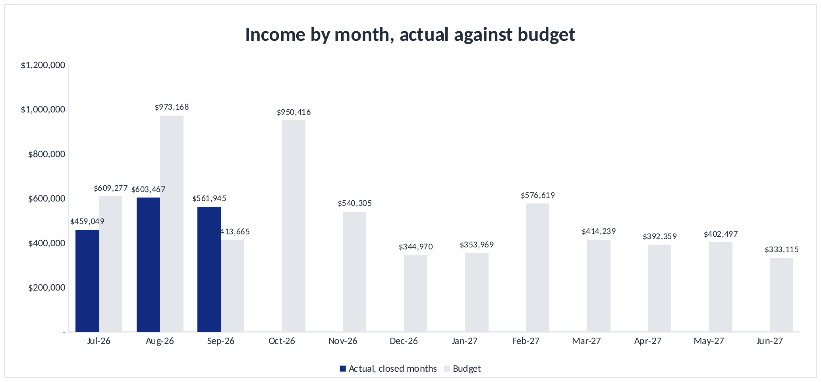
BUDGET AND OUTLOOK
Revenue by month against budget
COMMENTARY
Q1 came in (372)k behind on revenue, and almost all of it is Consulting and Video.
The remaining nine months are untouched original budget. They are not a forecast.
October alone is budgeted at 950k, nearly double our best month so far.
December carries a planned loss. The business closes for two weeks, so that is correct and should stay.
Recommend a Q1 rolling forecast: rebuild Consulting on real capacity and reset the margin assumptions.
Snipped from the Financial Controller Pack, Cost Analysis tab, total income by month, actual to date then budget.
Notes:
Revenue by month, actual for the three closed months and original budget for the rest.
Q1 actual 1,624,460 against a budget of 1,996,110, behind by 371,650.
The nine months from October are still at the budget set before the year started. October is budgeted at 950,416, higher than any month we have delivered.
Two things for the board. The Q1 variance is concentrated in Consulting and Video, which were budgeted on a resourcing level that does not exist. And the margin assumption in the budget is above what the business has delivered for two years, so even a month that hits the revenue number will miss the profit number.
My recommendation is a rolling forecast from Q2, rebuilding Consulting around actual capacity and resetting gross margin to delivered rates. December should stay as budgeted: the business closes for two weeks and the loss is real.

Slide 27
SUMMARY AND ACTIONS
What we agreed
Area | What we agreed | Owner | Due
P&L | Reforecast FY27 on margin, not revenue. At 38.9% gross margin break even needs 549k a month and we are running at 541k. | GC and FC | 31 Oct 26
Overhead keys | Events carries 111k of overhead on 73k of revenue and cannot be profitable on that key. Test the keys for FY28, do not change them mid year. | GC and FC | 30 Nov 26
Consulting | 20k of running costs against 4k of fees. Decide whether the department is rebuilt, merged into Integration, or closed. | GC | 30 Nov 26
Customers | Top three are 48.7% of revenue. Agree a named retention plan, and set the growth target on the second ten. | GC and Sales | 14 Nov 26
Cash | DSO 47.2 days. Getting to 30 releases 304k. Chase Aware Super and Deloitte Services P/L for Deloitte Services Trust first. | FC | 24 Oct 26
Utilisation | Five more points on Support and Events is worth about 16k a month at no extra cost. Set it as a target once timesheet coding is fixed. | Ops and FC | 30 Nov 26
Timesheets | Support shows 11 non-chargeable hours in a month. Correct the coding before utilisation is used to manage anyone. | Ops and FC | 31 Oct 26
Notes:
Seven actions, each with an owner and a date.
The first two matter most: reforecasting on margin rather than revenue, and testing the overhead keys. Everything else in this pack follows from those two numbers.
The Consulting decision cannot keep being deferred; it has carried running costs against almost no fees for three months.
The cash action is the only one that produces money this quarter, and the utilisation action is the largest controllable item.

Slide 28
cts
Seamless AV
Thank you
Questions and discussion
Notes:
Close on the two numbers that matter: break even needs 549,372 a month at our real margin, and we are running at 541,487. Everything else in the pack is detail underneath that.

